Slide 1
Stony valley contracting
Presentation: Suncor
September 20, 2024

Slide 2
Safety Moment
Fall Safety Alert: Incident Trends Spike from Nov 1 – Dec 1
Stay Ahead of the Curve
Boost Communication: Enhance safety meetings, send regular alerts, and focus on continuous education.
Increase Support: Additional staffing to cover weather-related challenges and holiday absences.
Stay Vigilant: Awareness! Awareness! Awareness!
Key Message
No task is ever so urgent that we can’t take the time to do it safely.
We take a "hands-on" approach to safety because every person’s wellbeing matters.
Our goal is for everyone to go home safe, every day.
Our Commitment
The health and safety of our employees and the people we work with will not be compromised.
We are committed to being an industry leader in health and safety
.
Notes:
HOPS and Samsara:
Before Samsara – MMC utilized a fleet tracking platform and its safety program to view its fleet and coach safety behaviors, this included Job Task Observations, Hazard Identifications, and Investigations along with lessons learned. We were reactive to safety events and much of our time was investigating why they occurred.
We were approached by Suncor/Slalom to pilot Samsara for them and we gladly accepted as we believe that the platform with its capabilities will allow our operations team to be proactive with managing our fleet and coach potential unsafe behaviors to minimize safety events. We understand that safety events will still happen and will follow HOPS to coach and mentor our operators, but having technology that could identify those behaviors before they happen is invaluable.
Samsara will score drivers based on their safety behaviors based on a set list of characteristics which are deemed to risk factors to our line of work, we will implement a safety incentive program to ensure that the best drivers on every shift over a monthly period are being incentivized for their safe driving habits. In addition, we are exploring the capability of installing cameras on the outside and back of the lube body as 50% of our work happens outside of the cab which then we will be able to observe job tasks to ensure that they are being performed as mentored.

Slide 3
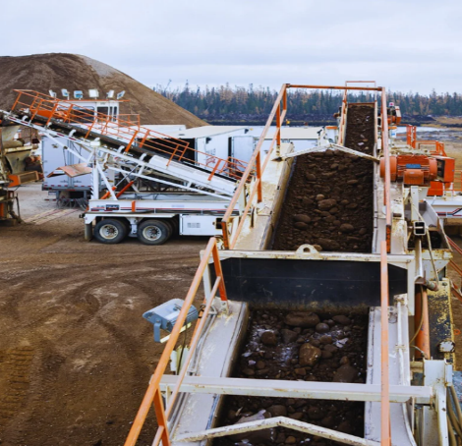
OUR MISSION
Our Mission is to consistently work with our customers and Indigenous partners - taking ‘hands-on’ entrepreneurial approach, resulting in the most cost-effective solutions while maintaining the highest standards of safety.
Notes:
HOPS and Samsara:
Before Samsara – MMC utilized a fleet tracking platform and its safety program to view its fleet and coach safety behaviors, this included Job Task Observations, Hazard Identifications, and Investigations along with lessons learned. We were reactive to safety events and much of our time was investigating why they occurred.
We were approached by Suncor/Slalom to pilot Samsara for them and we gladly accepted as we believe that the platform with its capabilities will allow our operations team to be proactive with managing our fleet and coach potential unsafe behaviors to minimize safety events. We understand that safety events will still happen and will follow HOPS to coach and mentor our operators, but having technology that could identify those behaviors before they happen is invaluable.
Samsara will score drivers based on their safety behaviors based on a set list of characteristics which are deemed to risk factors to our line of work, we will implement a safety incentive program to ensure that the best drivers on every shift over a monthly period are being incentivized for their safe driving habits. In addition, we are exploring the capability of installing cameras on the outside and back of the lube body as 50% of our work happens outside of the cab which then we will be able to observe job tasks to ensure that they are being performed as mentored.

Slide 4
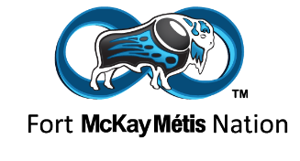
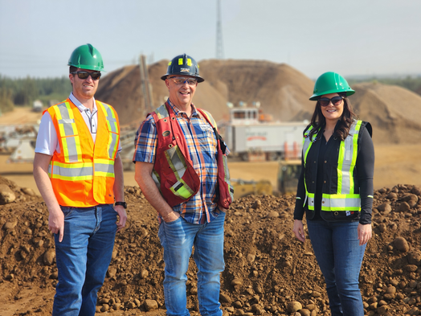
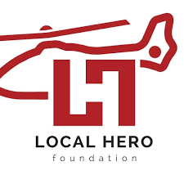
Indigenous Partnership
2022 – Stony Valley & McKay Metis Group partnered to form McKay Metis Sand & Gravel (MNSG)
This partnership helps to provide tangible benefits & economic prosperity to the Fort McKay Metis Nation. FMMN uses funds to support its housing, infrastructure and social supports for its members.
MMG, MNSG and it’s Operating Partner Stony Valley Contracting together support community initiatives such as the Northern Lights Health Foundation, Girls Inc, Local HERO Foundation, Boys & Girls Club, WB Food Bank and many local sports teams.
Notes:
HOPS and Samsara:
Before Samsara – MMC utilized a fleet tracking platform and its safety program to view its fleet and coach safety behaviors, this included Job Task Observations, Hazard Identifications, and Investigations along with lessons learned. We were reactive to safety events and much of our time was investigating why they occurred.
We were approached by Suncor/Slalom to pilot Samsara for them and we gladly accepted as we believe that the platform with its capabilities will allow our operations team to be proactive with managing our fleet and coach potential unsafe behaviors to minimize safety events. We understand that safety events will still happen and will follow HOPS to coach and mentor our operators, but having technology that could identify those behaviors before they happen is invaluable.
Samsara will score drivers based on their safety behaviors based on a set list of characteristics which are deemed to risk factors to our line of work, we will implement a safety incentive program to ensure that the best drivers on every shift over a monthly period are being incentivized for their safe driving habits. In addition, we are exploring the capability of installing cameras on the outside and back of the lube body as 50% of our work happens outside of the cab which then we will be able to observe job tasks to ensure that they are being performed as mentored.

Slide 5
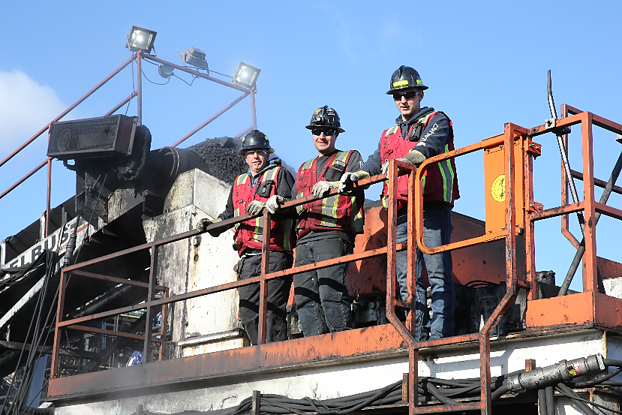
SAFETY FIRST
Exposure hours – 3 years 250,000-300,000 hours
Lost Time Injury – 0 (past 4 years)
Total Recordables – 0 (past 4 years)
No Medical Aids (past 3 years)
WCB – in a discount position (past 5 years)
Notes:
HOPS and Samsara:
Before Samsara – MMC utilized a fleet tracking platform and its safety program to view its fleet and coach safety behaviors, this included Job Task Observations, Hazard Identifications, and Investigations along with lessons learned. We were reactive to safety events and much of our time was investigating why they occurred.
We were approached by Suncor/Slalom to pilot Samsara for them and we gladly accepted as we believe that the platform with its capabilities will allow our operations team to be proactive with managing our fleet and coach potential unsafe behaviors to minimize safety events. We understand that safety events will still happen and will follow HOPS to coach and mentor our operators, but having technology that could identify those behaviors before they happen is invaluable.
Samsara will score drivers based on their safety behaviors based on a set list of characteristics which are deemed to risk factors to our line of work, we will implement a safety incentive program to ensure that the best drivers on every shift over a monthly period are being incentivized for their safe driving habits. In addition, we are exploring the capability of installing cameras on the outside and back of the lube body as 50% of our work happens outside of the cab which then we will be able to observe job tasks to ensure that they are being performed as mentored.

Slide 6
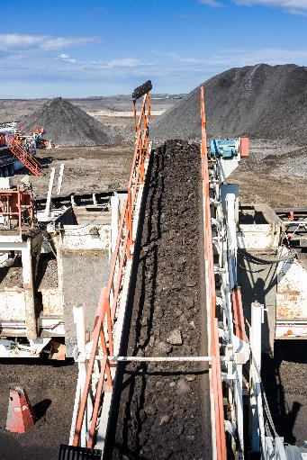
About
Stony Valley
OPERATIONS
Inception – January 2002
Services – 2 Main Elements:
Contracting Services
Providing onsite contracting services including aggregate production (crushing, screening, washing), rejects crushing & concrete recycling
Suncor Coke Screening (2 plants U1/U2)
Fort Hills Crushing
Syncrude 9/16” Coke
**Currently in contract renewal negotiations with Suncor
Aggregate Supply
Focus on sustainable production of a wide range of crushing, screening, loading & hauling to Industry Operators as well as local Contractors and Residents within RMWB.
Notes:
HOPS and Samsara:
Before Samsara – MMC utilized a fleet tracking platform and its safety program to view its fleet and coach safety behaviors, this included Job Task Observations, Hazard Identifications, and Investigations along with lessons learned. We were reactive to safety events and much of our time was investigating why they occurred.
We were approached by Suncor/Slalom to pilot Samsara for them and we gladly accepted as we believe that the platform with its capabilities will allow our operations team to be proactive with managing our fleet and coach potential unsafe behaviors to minimize safety events. We understand that safety events will still happen and will follow HOPS to coach and mentor our operators, but having technology that could identify those behaviors before they happen is invaluable.
Samsara will score drivers based on their safety behaviors based on a set list of characteristics which are deemed to risk factors to our line of work, we will implement a safety incentive program to ensure that the best drivers on every shift over a monthly period are being incentivized for their safe driving habits. In addition, we are exploring the capability of installing cameras on the outside and back of the lube body as 50% of our work happens outside of the cab which then we will be able to observe job tasks to ensure that they are being performed as mentored.

Slide 7
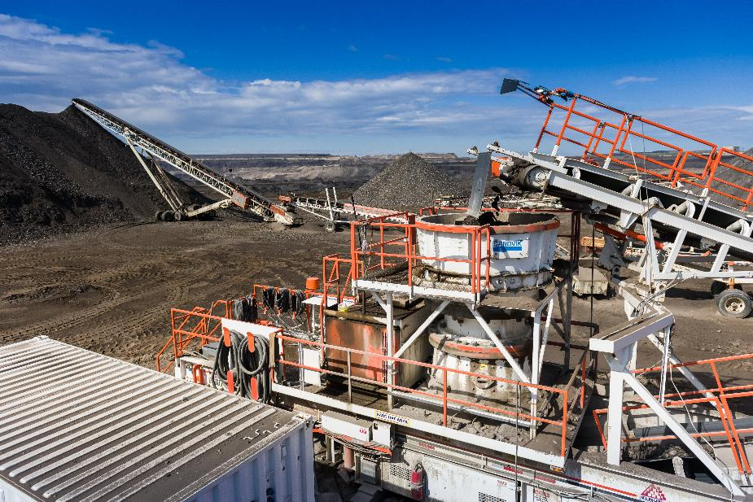
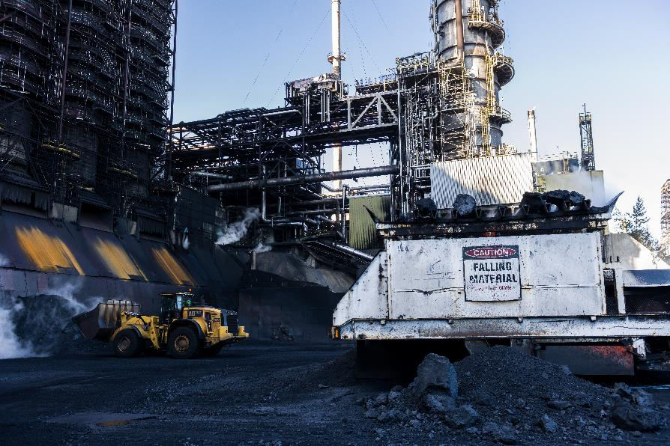
CONTRACTING SERVICES

Slide 8
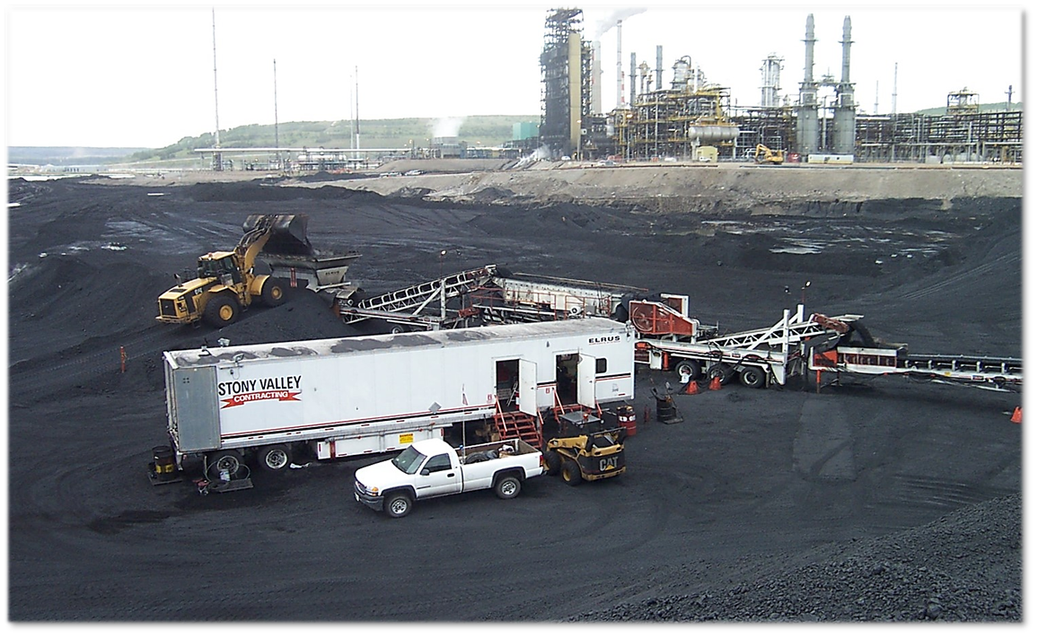
COKE PROCESSING
Processing Coke for more than 22 years

Slide 9
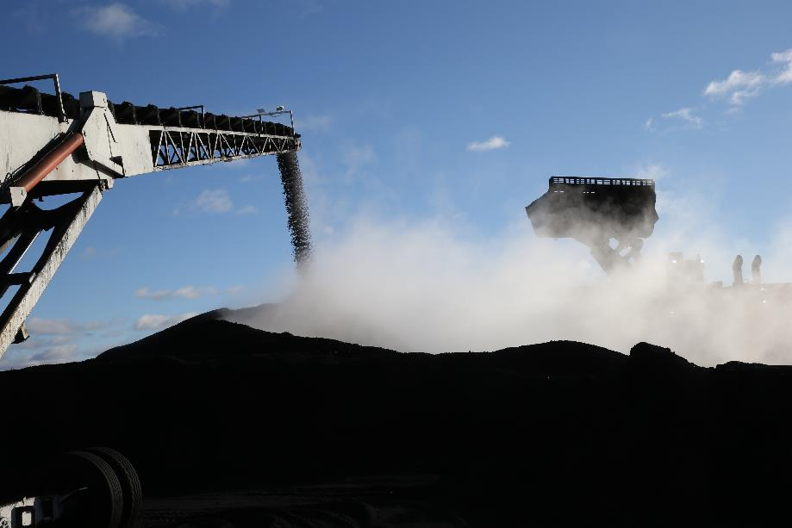
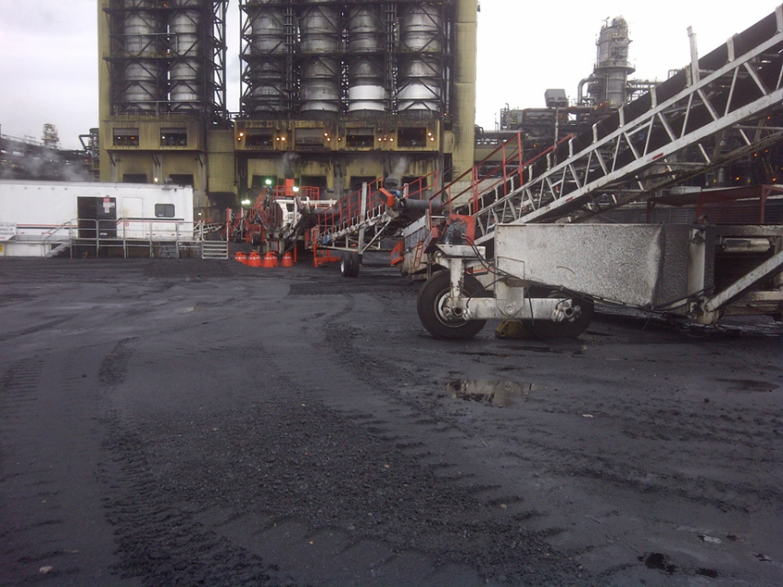
COKE PROCESSING – U1/U2
2004 – Processing began at U1
2006 – Processing began at U2

Slide 10
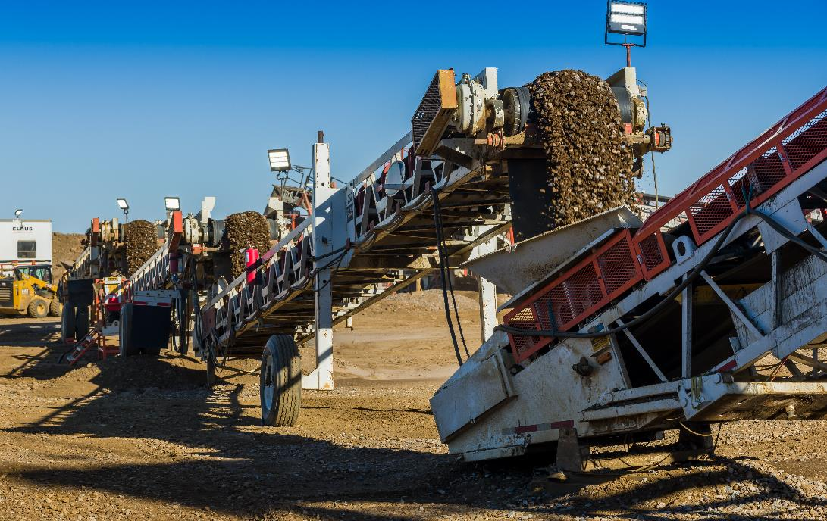
FORT HILLS CRUSHING
Stony Valley has 3 mobile crushing plants and mobile wash plants, including screening & conveyor handling systems
Crushing and screening at Fort Hills since 2018

Slide 11
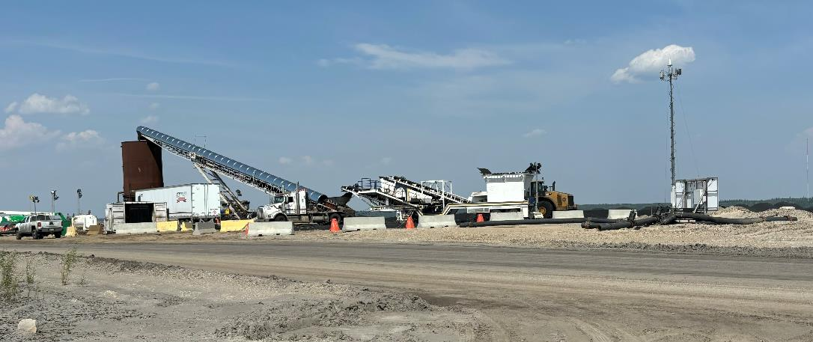
SYNCRUDE SCREENING/HYDRO TRANSPORT
Stony Valley can supply equipment for pilot/specialty projects
Syncrude 9/16” Coke for filter drains
2023 & 2024
Hydro Transport
2022 & 2024

Slide 12
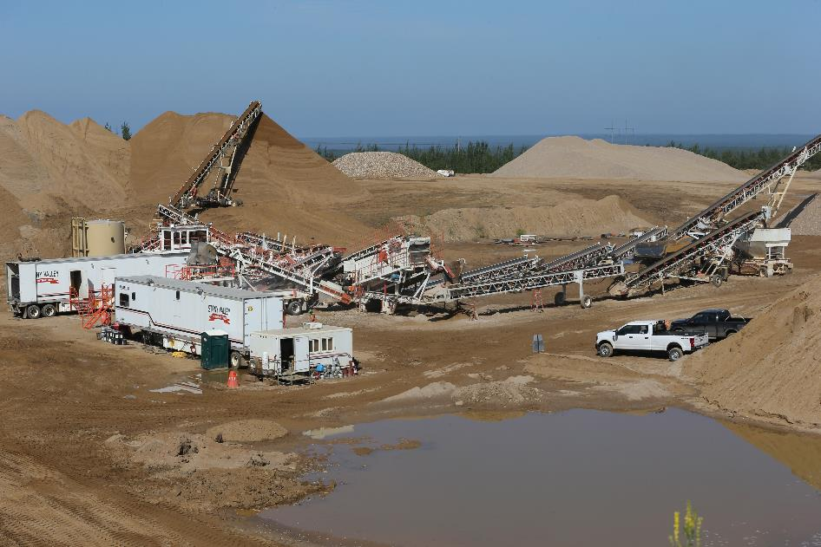
CONTRACTING CHALLENGES
EQUIPMENT IS SPECIALIZED
SIMILAR TO OIL RIG WORK – IN ONE LOCATION UNTIL WORK IS COMPLETE
PLANNING & SCHEDULING WITH CUSTOMERS IS IMPORTANT
COMPLETION OF WORK AHEAD OF SCHEDULE
Notes:
HOPS and Samsara:
Before Samsara – MMC utilized a fleet tracking platform and its safety program to view its fleet and coach safety behaviors, this included Job Task Observations, Hazard Identifications, and Investigations along with lessons learned. We were reactive to safety events and much of our time was investigating why they occurred.
We were approached by Suncor/Slalom to pilot Samsara for them and we gladly accepted as we believe that the platform with its capabilities will allow our operations team to be proactive with managing our fleet and coach potential unsafe behaviors to minimize safety events. We understand that safety events will still happen and will follow HOPS to coach and mentor our operators, but having technology that could identify those behaviors before they happen is invaluable.
Samsara will score drivers based on their safety behaviors based on a set list of characteristics which are deemed to risk factors to our line of work, we will implement a safety incentive program to ensure that the best drivers on every shift over a monthly period are being incentivized for their safe driving habits. In addition, we are exploring the capability of installing cameras on the outside and back of the lube body as 50% of our work happens outside of the cab which then we will be able to observe job tasks to ensure that they are being performed as mentored.

Slide 13
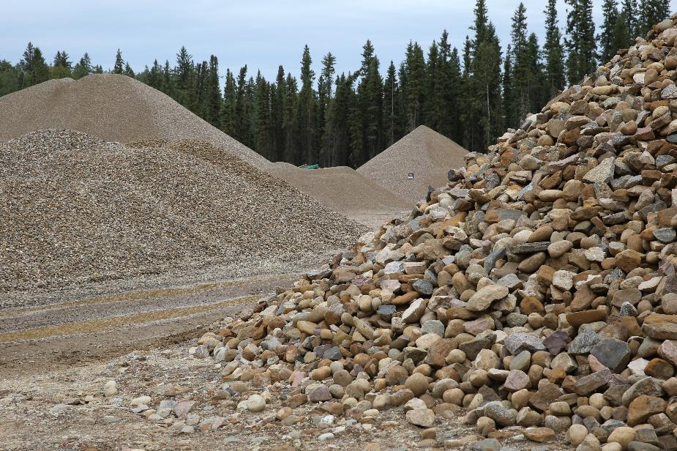
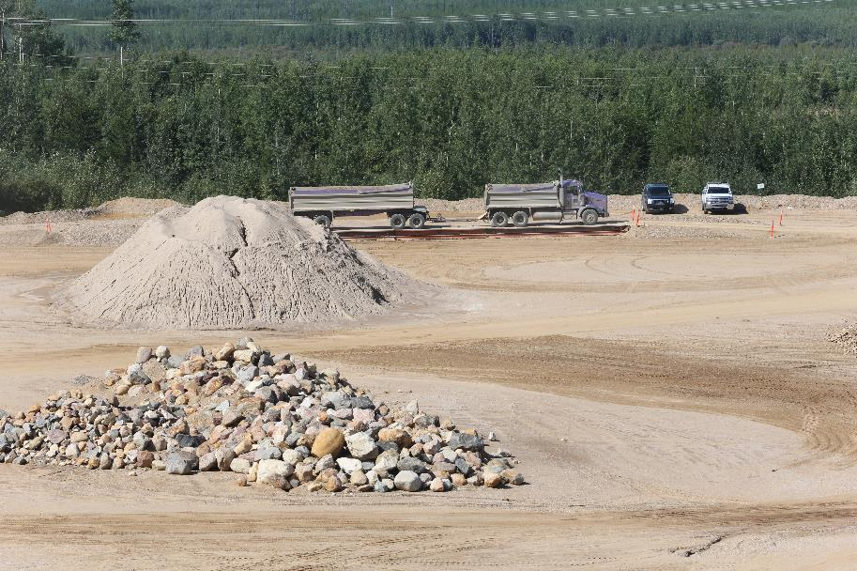
Aggregate supply SERVICES

Slide 14
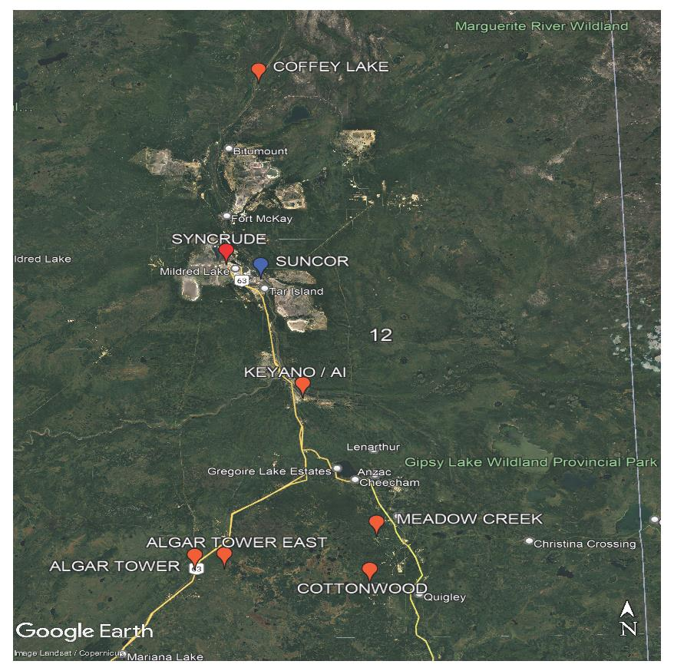
AGGREGATE SUPPLY RESOURCES
Coffey Lake – 40 million tonnes
Keyano Pit – 1 million tonnes (marshalling yard)
Hwy 63 – 12 million tonnes
Hwy 881 13 million tonnes

Slide 15
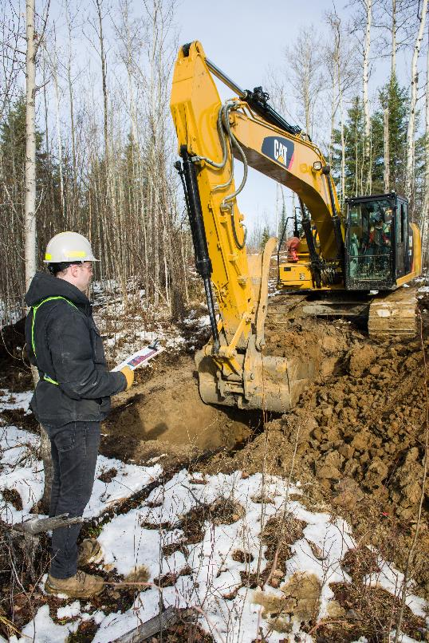
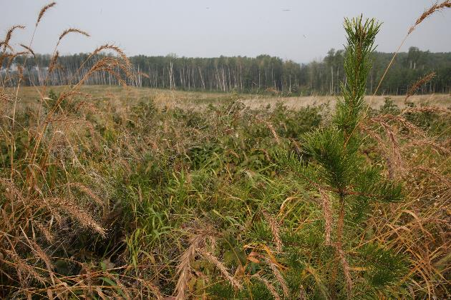
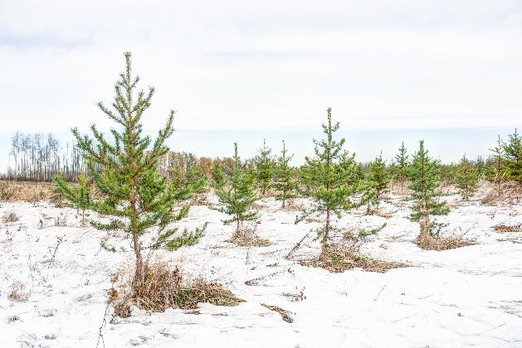
LAND DEVELOPMENT & APPROVALS
Prospect & develop land within RMWB
We have the resources to locate and meet regulatory requirements to obtain approvals for aggregate development
Reclamation

Slide 16
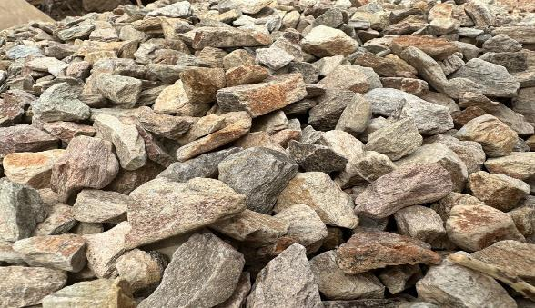
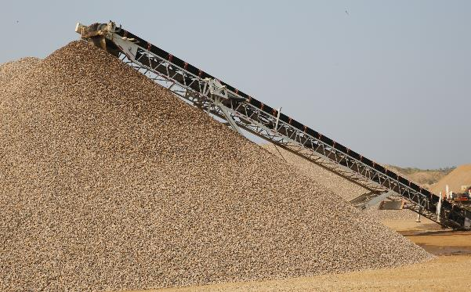
INVENTORIES – SVC holds up to 300,000 tonnes of aggregates
Heavy Rock
Washed/
Screened
Rock
Concrete Aggregates
Road Crush

Slide 17
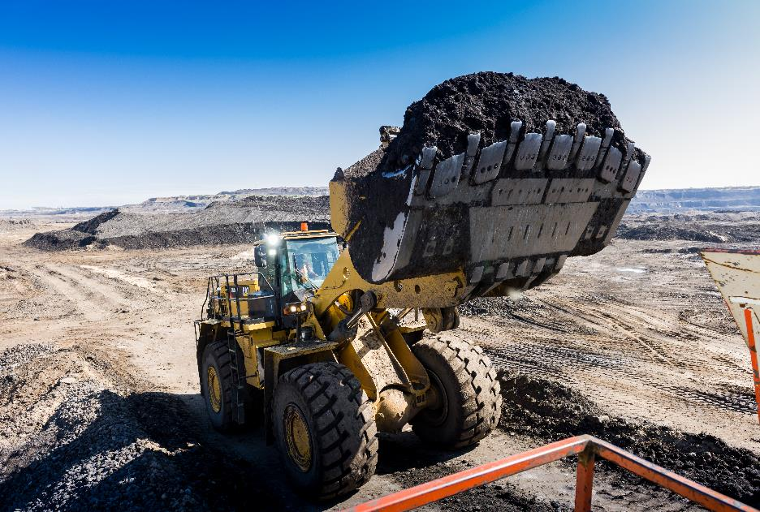
AGGREGATE SUPPLY CHALLENGES
SPECIALIZED ROCK
HEAVY RIP RAP – EROSION CONTROL
SUMMER PRODUCTION – HARD TO PRODUCE DURING WINTER MONTHS
TRUCKING (SITE ACCESS/AVAILABILITY)
Notes:
HOPS and Samsara:
Before Samsara – MMC utilized a fleet tracking platform and its safety program to view its fleet and coach safety behaviors, this included Job Task Observations, Hazard Identifications, and Investigations along with lessons learned. We were reactive to safety events and much of our time was investigating why they occurred.
We were approached by Suncor/Slalom to pilot Samsara for them and we gladly accepted as we believe that the platform with its capabilities will allow our operations team to be proactive with managing our fleet and coach potential unsafe behaviors to minimize safety events. We understand that safety events will still happen and will follow HOPS to coach and mentor our operators, but having technology that could identify those behaviors before they happen is invaluable.
Samsara will score drivers based on their safety behaviors based on a set list of characteristics which are deemed to risk factors to our line of work, we will implement a safety incentive program to ensure that the best drivers on every shift over a monthly period are being incentivized for their safe driving habits. In addition, we are exploring the capability of installing cameras on the outside and back of the lube body as 50% of our work happens outside of the cab which then we will be able to observe job tasks to ensure that they are being performed as mentored.

Slide 18
ANY QUESTIONS?
Notes:
HOPS and Samsara:
Before Samsara – MMC utilized a fleet tracking platform and its safety program to view its fleet and coach safety behaviors, this included Job Task Observations, Hazard Identifications, and Investigations along with lessons learned. We were reactive to safety events and much of our time was investigating why they occurred.
We were approached by Suncor/Slalom to pilot Samsara for them and we gladly accepted as we believe that the platform with its capabilities will allow our operations team to be proactive with managing our fleet and coach potential unsafe behaviors to minimize safety events. We understand that safety events will still happen and will follow HOPS to coach and mentor our operators, but having technology that could identify those behaviors before they happen is invaluable.
Samsara will score drivers based on their safety behaviors based on a set list of characteristics which are deemed to risk factors to our line of work, we will implement a safety incentive program to ensure that the best drivers on every shift over a monthly period are being incentivized for their safe driving habits. In addition, we are exploring the capability of installing cameras on the outside and back of the lube body as 50% of our work happens outside of the cab which then we will be able to observe job tasks to ensure that they are being performed as mentored.

